Slide 1

Early Learning STEM Australia
2018 pilot educators workshop
Day Two
ELSA is funded by the Australian Government Department of Education and Training through the National Innovation and Science Agenda

Slide 2
Welcome
Housekeeping
Notes:
Welcome back
Reminder of housekeeping – toilets, emergency procedures etc.
End of day travel arrangements

Slide 3
Where are we today?

Slide 4
STEM Practices
Applying our knowledge

Slide 5
Your turn
Can you think of a learning experience that you would do differently now based on your new knowledge?
On the big paper write what you did and what you would now do?

Slide 6
Gallery Walk
Have a look at what others have done and would like to change
What do you notice?

Slide 7
Digital technology in early childhood learning
Ideas about digital play

Slide 8
Key questions
What do we mean by digital technologies and digital play?
How do we develop approaches that support play based learning?
What is the state of play with technology in the early years?
How do we develop, appropriate, and intentional use of technology with young children?

Slide 9
Experience
Thinking back to your first experience with App1
What did you notice?
What did you see/talk about?
How do you think children would use it? Expected & Unexpected ways
Think – Record – Share in pairs (Post it notes)
Observing digital play
Observe: the sayings (ideas), the doings (methods), and the ways of relating (values)
Form groups of four. In pairs play App1 together. The other pair makes observations and take notes
Share

Slide 10
Represent: Looking differently
There is value in thinking about the different ways that children interact with technology (cf Crooke)
collaboration with technology (on the app)
collaboration in relation to technology (about the technology)
collaboration at technology (small groups)
collaboration around and through technology (networking)
Crook, C. (1996). Computers and the collaborative experience of learning. Psychology Press.
Notes:
Crook analyses the variety of different ways in which computers can be part of the collaborative experience of learning. He has chapters on:collaboration with computers
collaboration in relation to computers
collaboration at computers
collaboration around and through computers
The idea of working with a computer brings to mind a solitary individual sitting at a keyboard working on a computer program. The program could be a computer based learning program. Collaboration with computers is the goal of making such programs "reproduce the social character of a face-to-face tutorial dialogue". (Crook, C. 1994 Chapter 4 and p. 119) A software designer, therefore, would try to make the computer respond to the learner with the intelligence (or otherwise!) of a human tutor. By collaboration in relation to computers, Crook appears to mean tutor-student interaction about computers, not involving working at the computer, but supportive of work with a computer. Discussing things about computer work in a lecture might be an example. Crook says:"This is the...sense in which pupils are engaged in some activity involving their teachers but where those teachers' contributions are more indirect, or mediated, or deferred. That is, they make only intermittent contact with the task or refer to it on occasions when it is not actually in progress." (Crook, C. 1994 Chapter 5 and p.100)
Collaboration at computers refers to times when small groups of learners work on the same computer based problem at the same time. Two students helping one another with email software could be an example. Collaboration around computers refers to learners working together more informally than when a small group is working at a computer on a common task. Crook says that "material environments will constrain and facilitate a whole range of social interactions that can occur within them". So, collaboration between students who happen to be individually working on computers in the same room, may be encouraged or discouraged by the room layout. Collaboration through computers means collaborating through networks, including the internet. It can range from straightforward collaboration through email and the web, through to video conferencing and the virtual classroom. Crook says that our concept of collaboration has to include circumstances in which collaboration is dislocated in time and when participants are not co-present. This is a central feature of interacting through computers.

Slide 11
Represent: Tools to think/act/feel with
About Mitchel Resnick
LEGO Papert Professor of Learning Research at the MIT Media Lab
Lifelong Kindergarten research group developed the Scratch programming software and online community (scratch.mit.edu)
Worked with LEGO for over 30 years on the development of new educational ideas and products, including LEGO Mindstorms and WeDo robotics kits
Co-founded the Computer Clubhouse project, an international network of 100 after-school learning centers where youth from low-income communities learn to express themselves creatively with new technologies
Notes:
Lifelong Kindergarten: Cultivating creativity through projects, passion, peers and play. Mitch Resnick, LEGO Papert Professor of Learning Research, MIT
“Human creativity moves hand in hand with technology” Sir Ken Robinson
“The role of the teacher is to create the conditions for invention rather than provide ready-made knowledge” Seymour Papert
Technology as tools, objects and experiences to-think-with-together

Slide 12
Represent: Tools to think/act/feel with
“Human creativity moves hand in hand with technology” Sir Ken Robinson
“The role of the teacher is to create the conditions for invention rather than provide ready-made knowledge” Seymour Papert
ELSA - Technology as tools, objects and experiences to-think-with-together
Notes:
Lifelong Kindergarten: Cultivating creativity through projects, passion, peers and play. Mitch Resnick, LEGO Papert Professor of Learning Research, MIT
“Human creativity moves hand in hand with technology” Sir Ken Robinson
“The role of the teacher is to create the conditions for invention rather than provide ready-made knowledge” Seymour Papert
Technology as tools, objects and experiences to-think-with-together

Slide 13
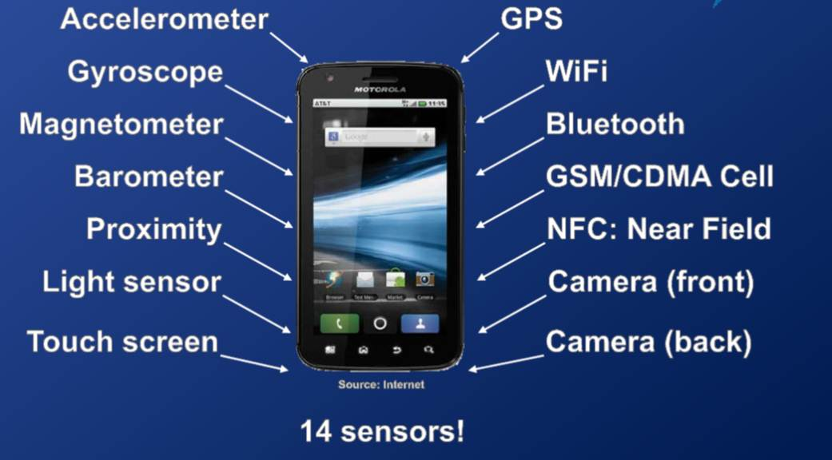
Powerful tools
Mobile learning
Bellanews.com
Notes:
The mobile is a computer and a sophisticated sensor platform that can be used for learning

Slide 14
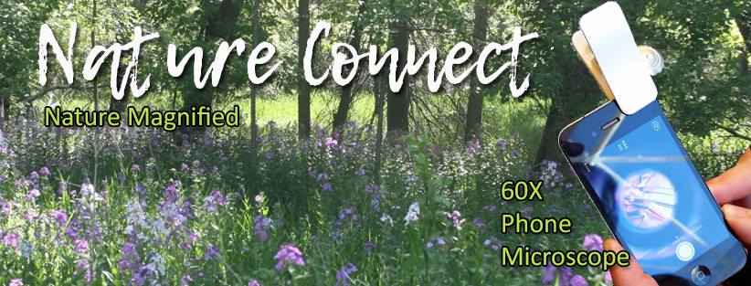

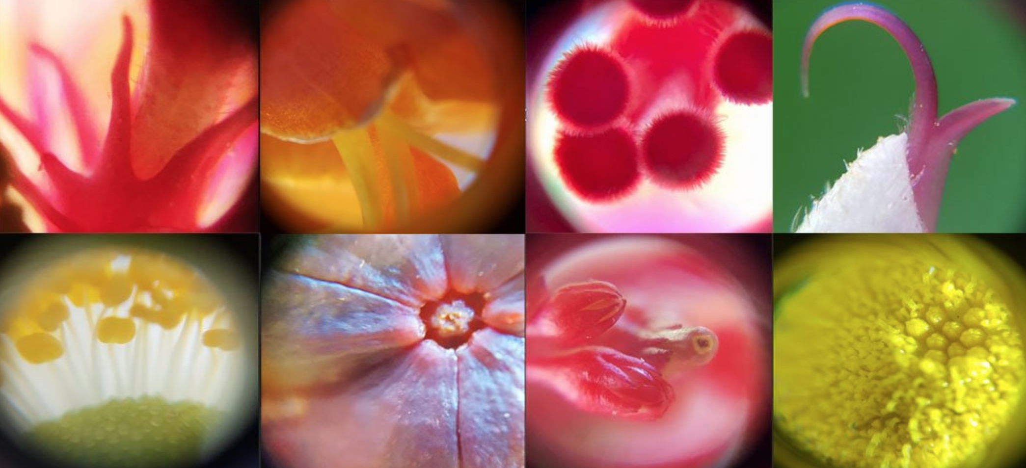
Notes:
Phone-based microscopy

Slide 15
Experience: 60X
In small groups, take a 60x scope and capture three images/videos. (You will need to remove the ipad cover)
Generate, ‘What’ questions for each image/video
Join another group and share/narrate your findings.

Slide 16
Apply: Noticing digital play
How can we notice digital play differently?
How can we rethink digital play in our own settings?
How will you reimagine the technology as a:
window
mirror
lens (magnifying glass or telescope)
portal to another world
tool to augment the digital and real world

Slide 17
Apply: Ten Tips for Educators/Families
Show examples to spark ideas (Imagine)
Encourage messing around (Imagine)
Provide a wide variety of materials (Create)
Embrace all types of making (Create)
Emphasize process, not product (Play)
Extend time for projects (Play)
Play the role of matchmaker (Share)
Get involved as a collaborator (Share)
Ask good questions (Reflect)
Share your own reflections (Reflect)
Creative Learning Spiral (Courtesy of Mitchel Resnick)

